Slide 1
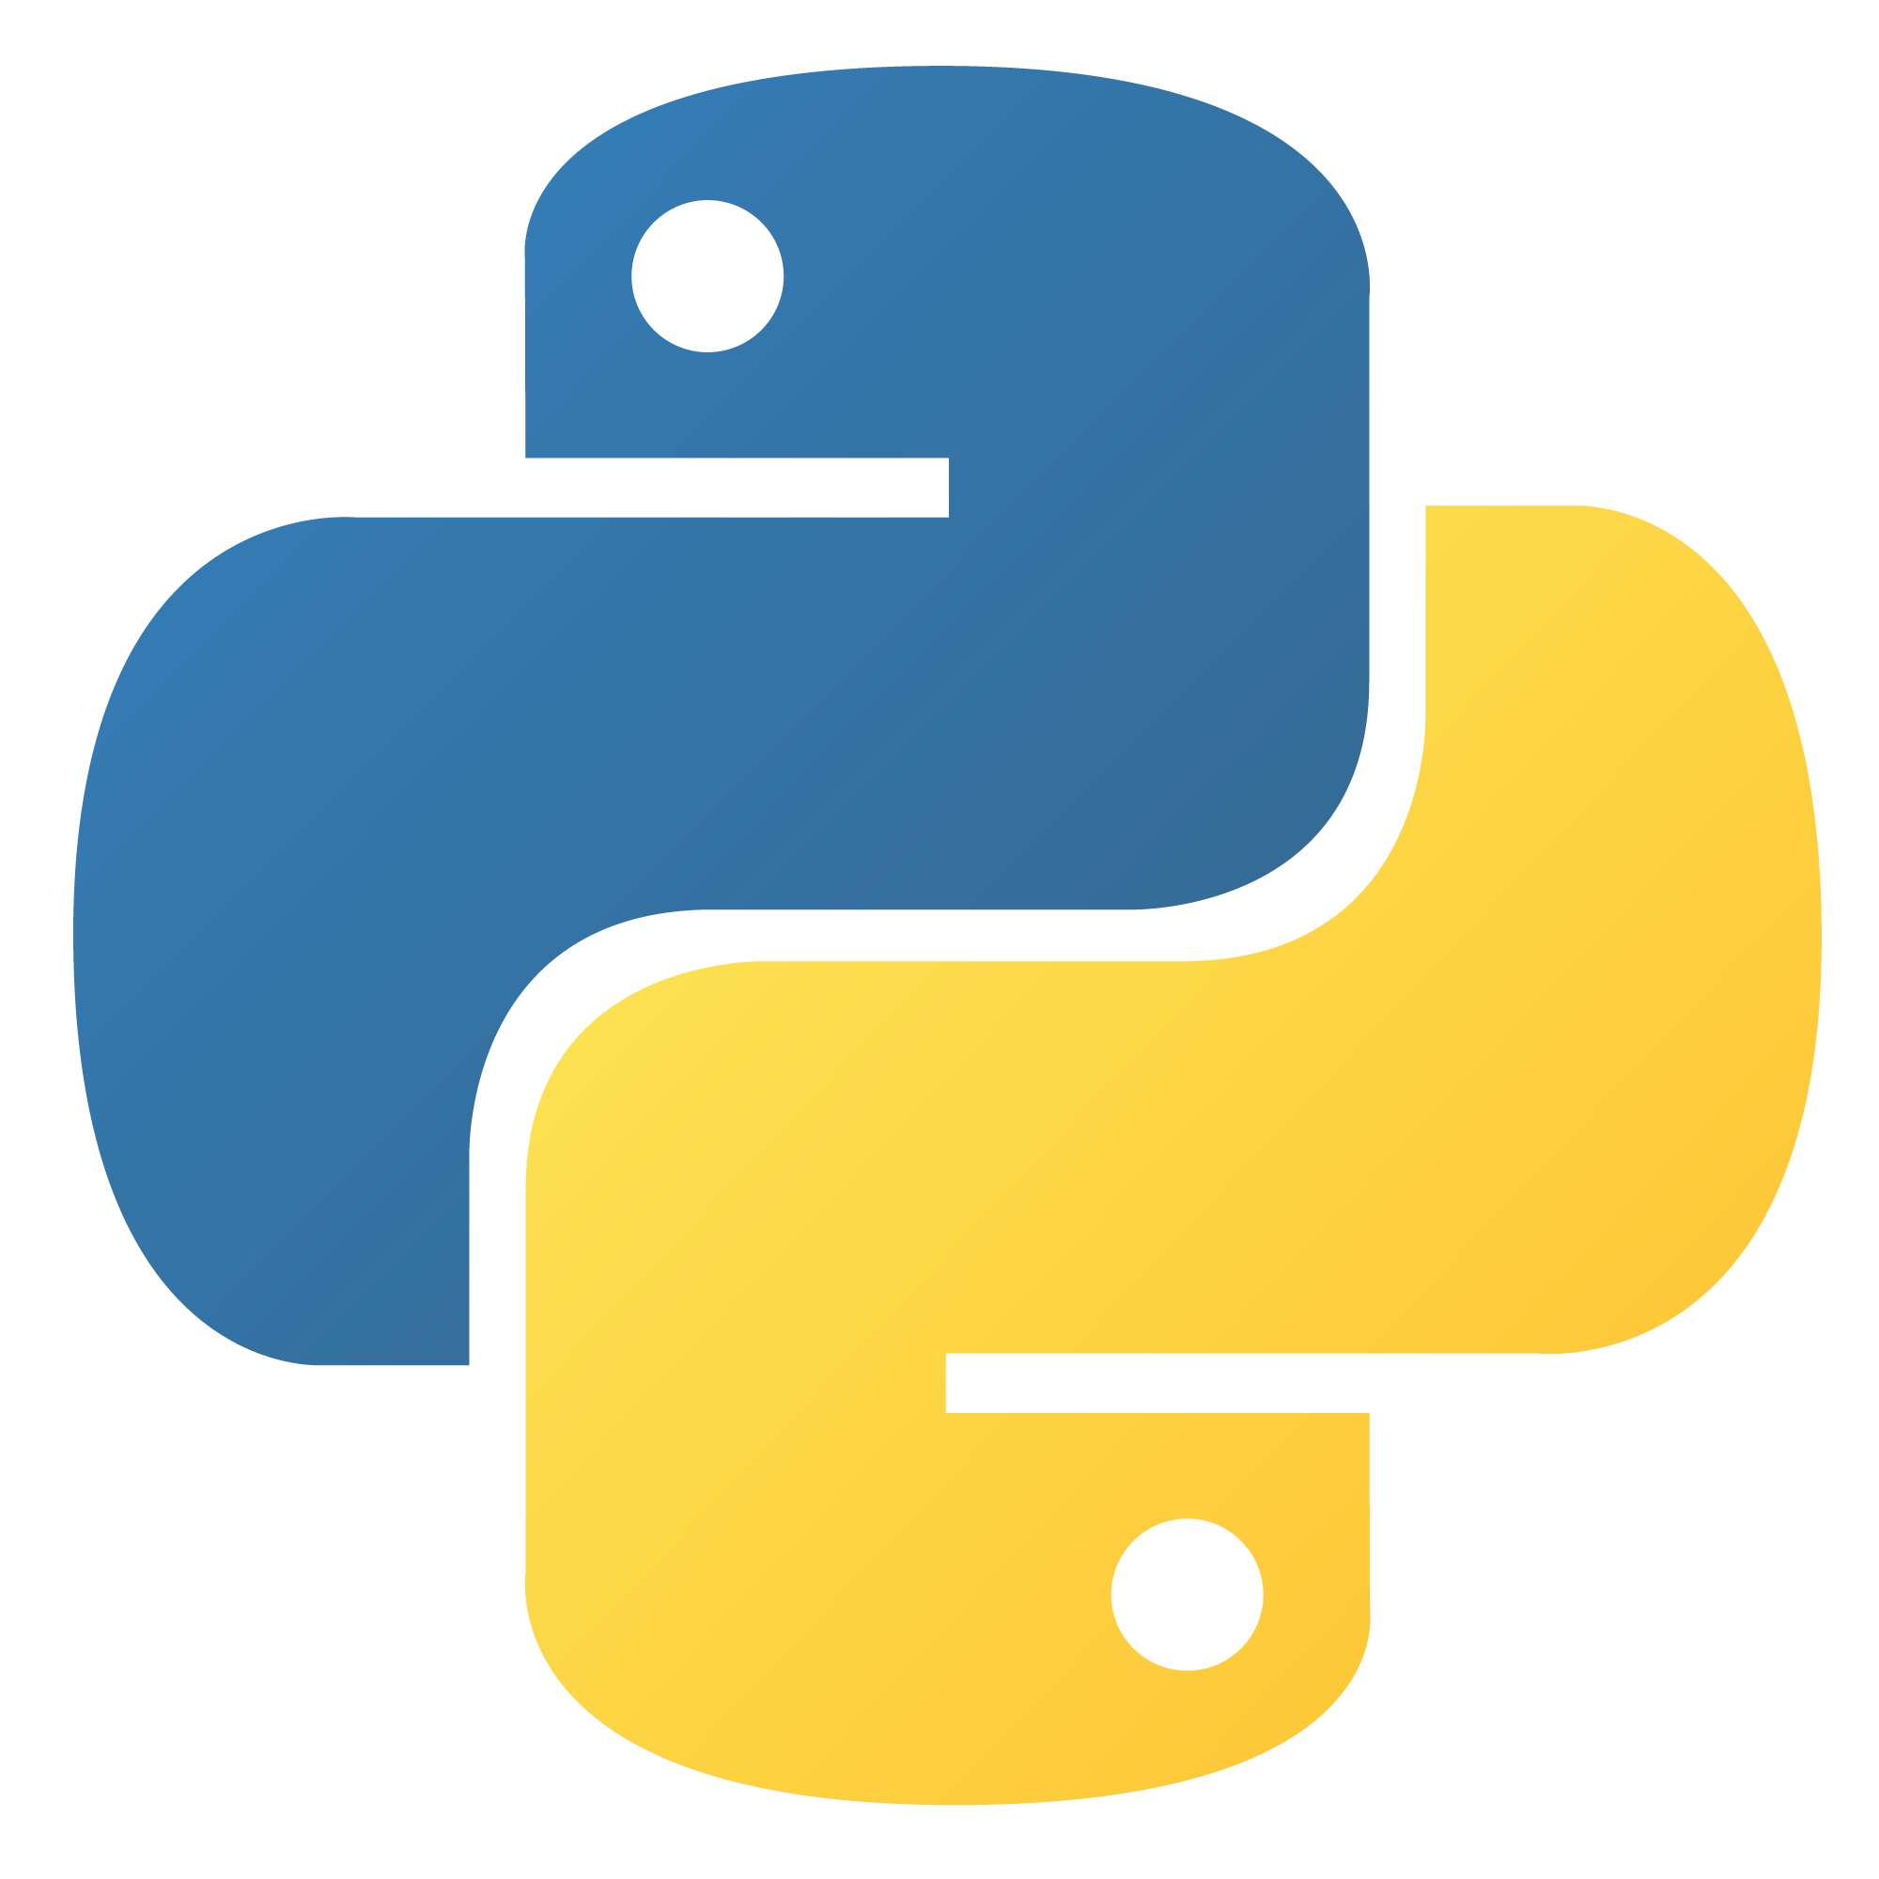
PYTHON PROGRAMMING & ITS INTRODUCTION
BY: ADITYA BHURA
This Photo by Unknown Author is licensed under CC BY-SA

Slide 2
Description about python: Python is a high-level, general-purpose programming language. It was created by Guido Van Rossum in 1991.
Features:
Readable and Easy to learn
Interpreted
Dynamic Typing
Open Source
Large Standard Librabry
Cross Platform

Slide 3
PYTHON DATATYPES:
INT - (Integer Values)
FLOAT - (Floating Values)
STRING - (Str & Booleans)
LIST - []
TUPLE - ()
SET - {}
DICTIONARY – {Key:Value}

Slide 4
STANDS ON:
INITIALIZATION
OPERATORS
TYPE CONVERSION
BUILT IN FUNCTIONS

Slide 5
INITIALIZATION:
RULES FOR INITIALIZING VARIABLES :-
A Pyhton variable must start with a letter or underscore.
A Python variable name cannot be start with a number or special symbols(@,#,$).
A Python variable name can only contain alpha-numeric characters and underscores (A-Z , a-z , 0-9 , _).
Variables names in Python are case sensitive(age,Age,AGE are three different variables).
There are some Reserved Words(Keywords) in python which cannot be used as variable names in python.
Syantax :- variable_name = initial_value

Slide 6
OPERATORS: Operators are used to perform some specific operations on values and variables. Types:-
Arithmatic operators :- These operators are used to perform basic mathematical operations like addition, subtraction, multiplication and division.
Assignment operators :- These operators are used to assign values to the variables.
Logical operators :- These operators are used to perform logical AND, logical OR and logical NOT. It is used to combine conditional statements.
Bitwise operators :- These operators act on bits and perform bit by bit operations. These are used to operate on binary numbers.
Relational operators :- These operators compares the values and either used to return true or false according to the condition.

Slide 7
TYPE CONVERSION: Type conversion functions are used to directly convert one data type to another which is useful in day to day and competitive programming.
Types –
Implicit Type Conversion :- In implicit type conversion, the python interpreter automatically converts one data type to another without any user involvement.
Explicit Type Conversion :- In explicit type conversion, the data type is manually changed by the user as per their requirement. With explicit type conversion, there is a risk of data loss since we are forcing an expression to be changed in some specific data type.

Slide 8
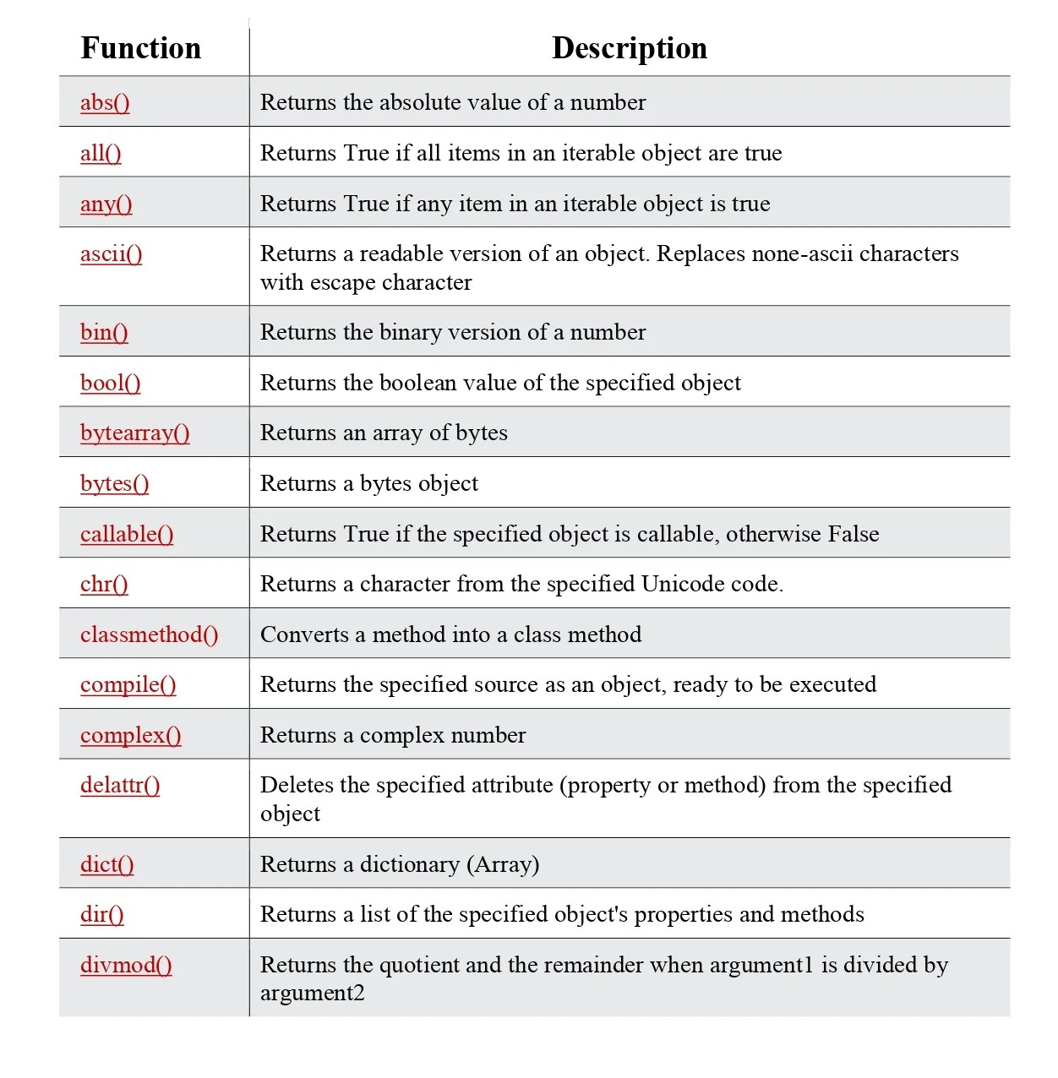
BUILT-IN FUNCTIONS:
Built-In functions in python are pre-defined functions provided by the python language that can be used to perform common tasks.

Slide 9
STRINGS: A string is a data structure in python programming that represents a sequence of characters. It is an immutable data type, meaning that once you have created a string, you cannot change it. Pyhton string are used widely in many different applications, such as storing and manipulating text data, representing names, address and other types of data used that can be represented as text.
Methods –
Square brackets can be used to access elements of the string.
Pyhton does not have a character data type, a single character is simply a string with a length of 1.
We can combine strings and numbers by using f-strings or the format() method.
You can return a range of characters by using the slice syntax. Specify the start index and the end index, separated by a colon, to return a part of the string.

Slide 10
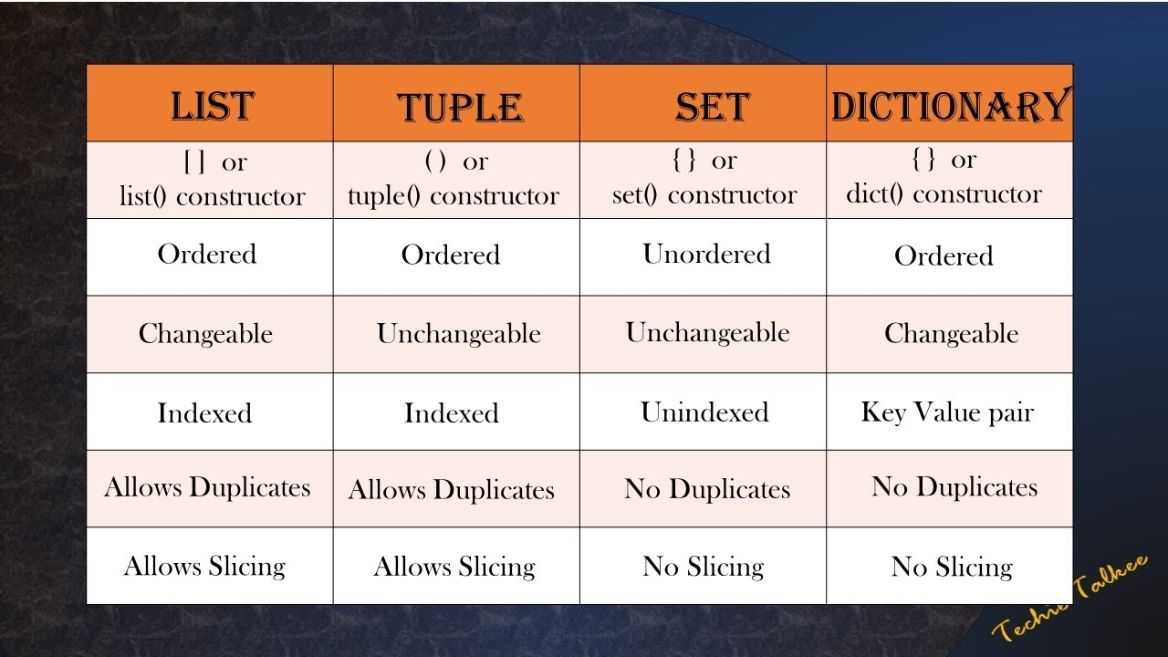
LIST, TUPLE, SET :
List :- Lists are ordered collections that can hold multiple elements.
Tuple :- Tuples are similar to lists but are immutable (cannot be changed after creation).
Set :- Sets are unordered collections of unique elements.

Slide 11
DICTIONARY : Dictionary are used to store data values in key and value pairs. A dictionary is a collection which is ordered, changeable and do not allow duplicates.
Methods :-
Creation : Dictionaries can be created using curly braces { } with key-value pairs, or using the dict( ) function.
Accessing Values : Values can be accessed using their keys.
Modifying Values : You can add new key-value pairs or update existing ones.
Deleting Items : Items can be removed using the del statement or the pop( ) method.
Cheking Keys : You can check if a key exists using the in keyword.
Iteration : You can iterate over keys, values, or key-value pairs.

Slide 12
THANK YOU !

